Slide 1
PHONEPE PULSE
Santhosh S
BADM
DMT6

Slide 2
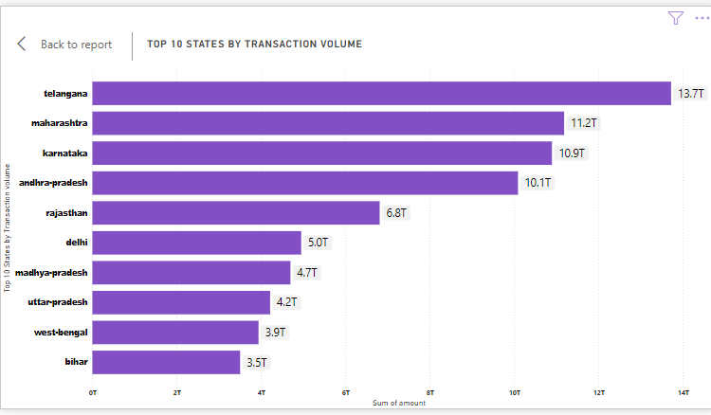

Slide 3
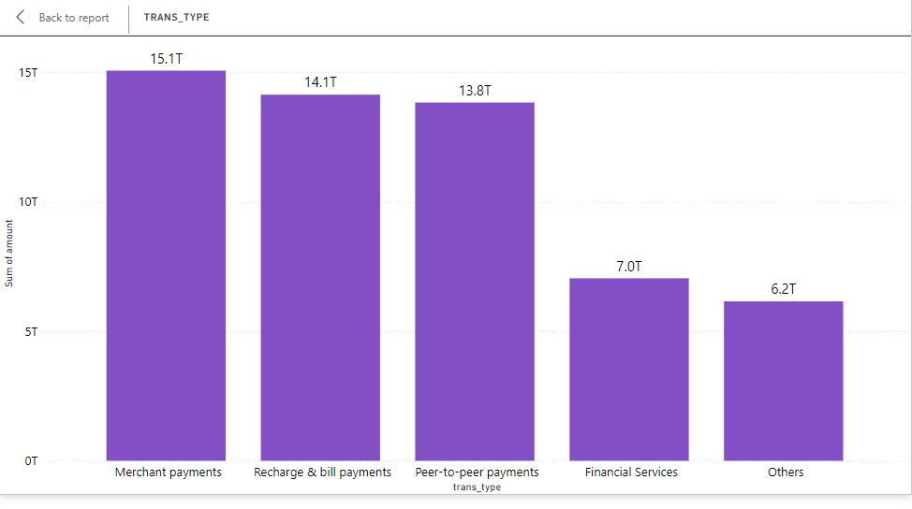

Slide 4
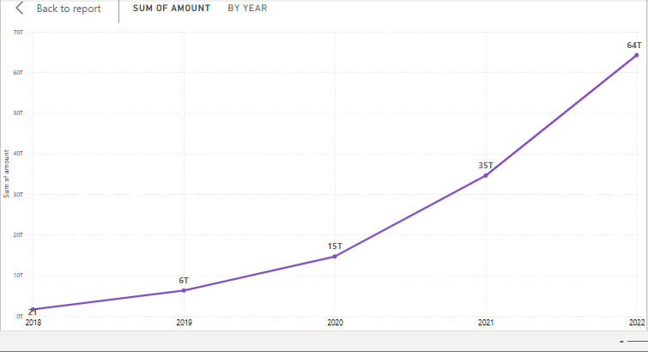

Slide 5
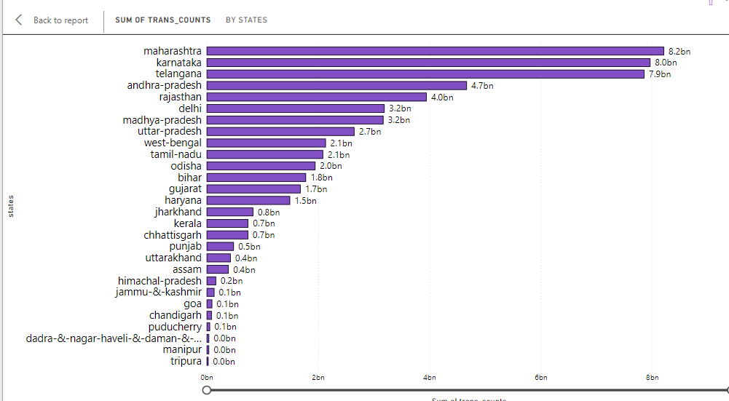

Slide 6
